Slide 1

Download & Installation instructions Xilinx Vivado
Version 2022.2

Slide 2
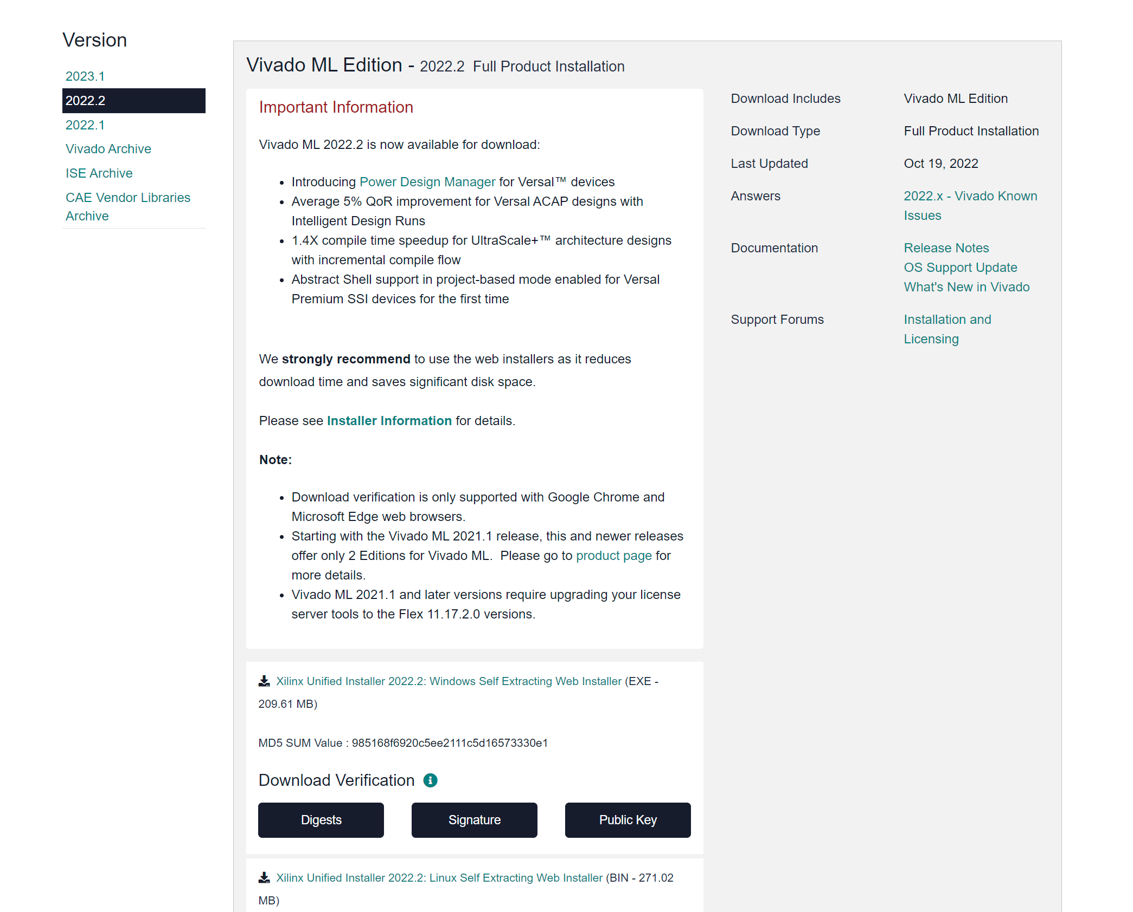
Go to download website and choose 2022.2 https://www.xilinx.com/support/download/index.html/content/xilinx/en/downloadNav/vivado-design-tools/archive.html
Select this for windows machine

Slide 3
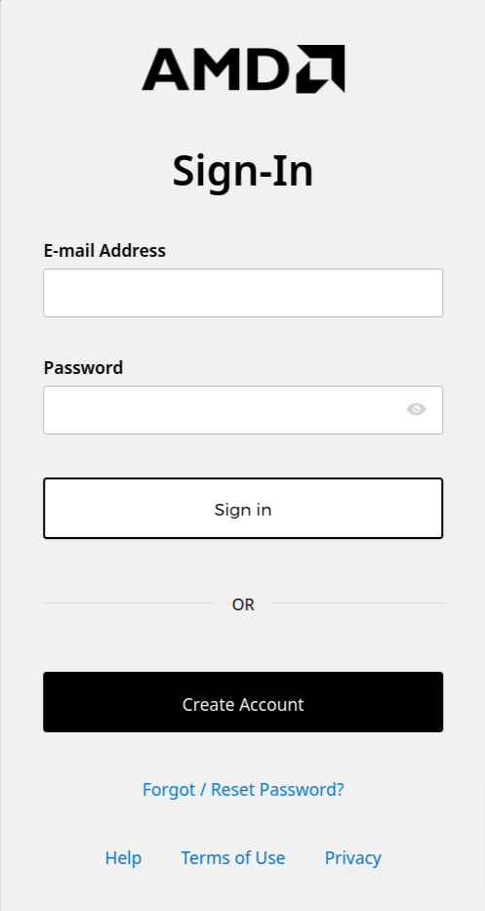
Sign into Xilinx account (Create one with preferably UofA email ID if new user, then sign in)

Slide 4
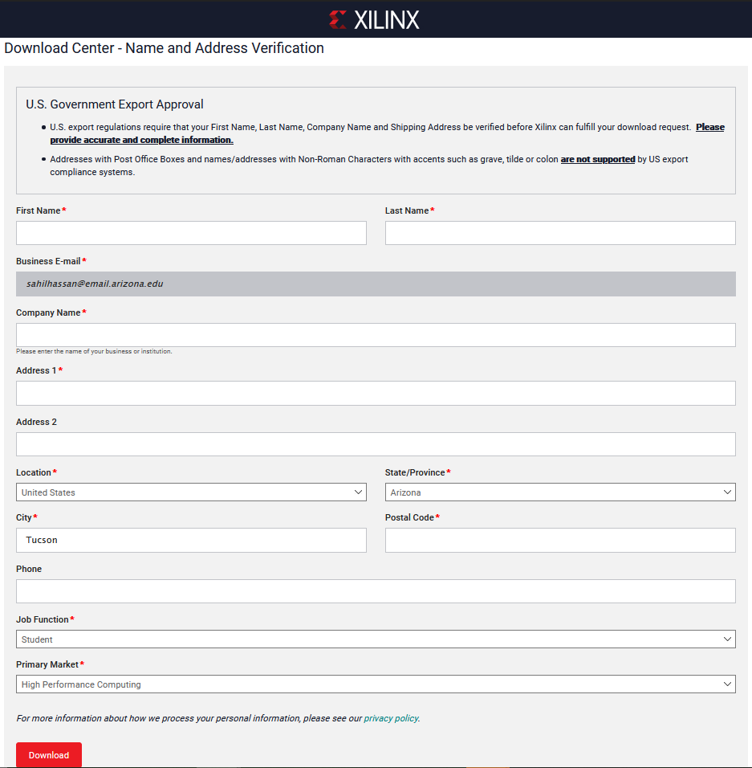
Fill out verification form and hit Download

Slide 5
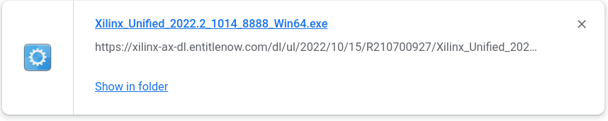
The following file should be downloaded

Slide 6
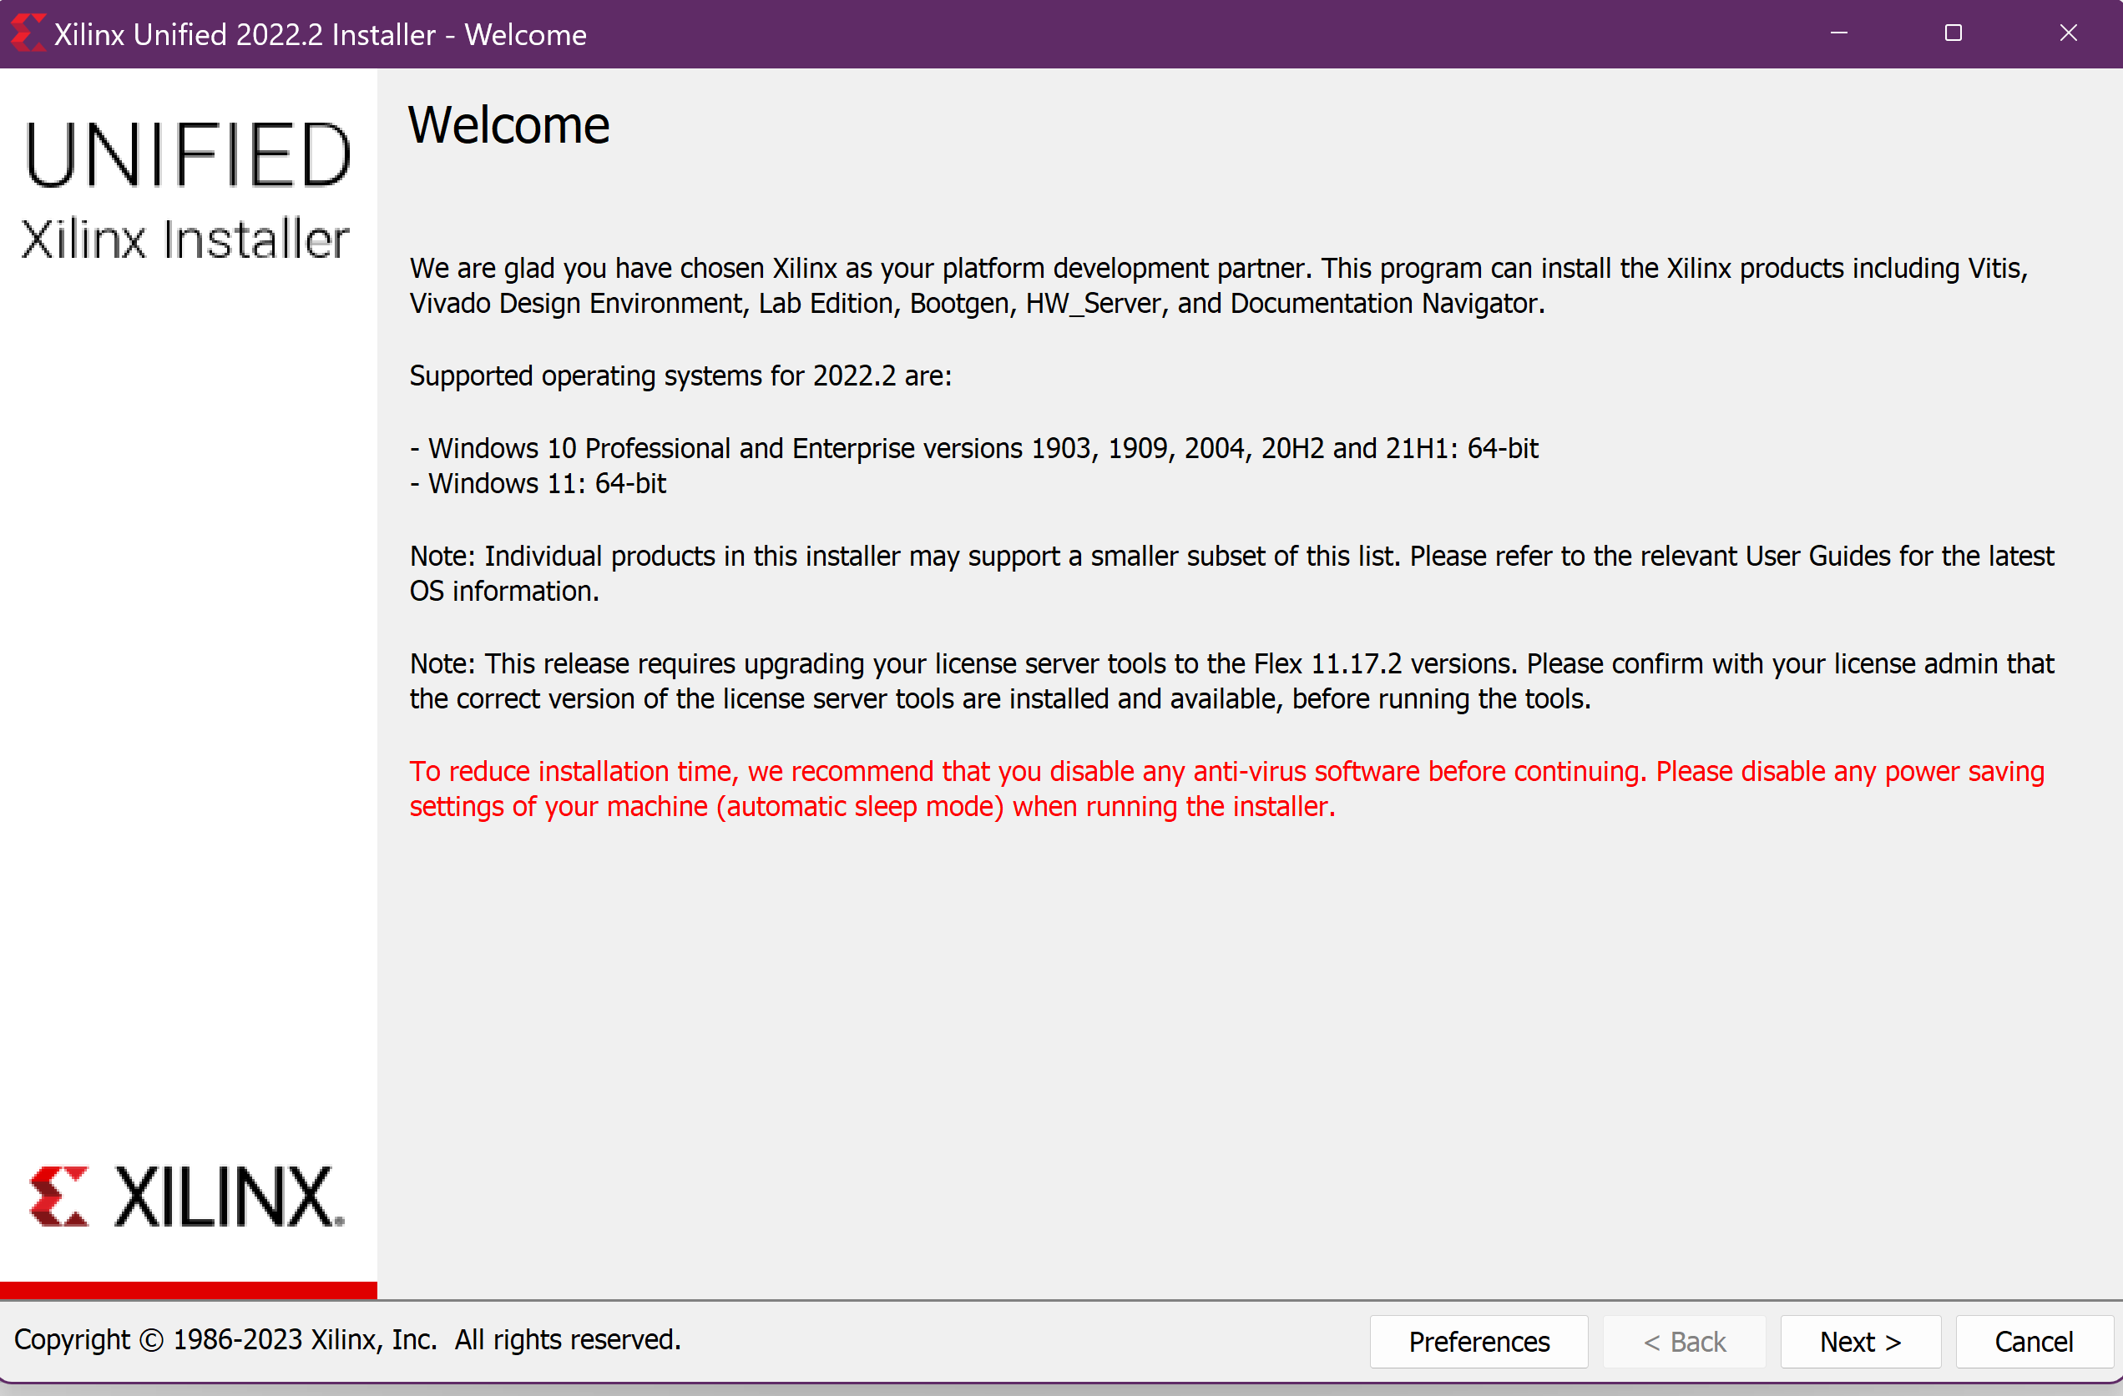
Run the installer to get the following interface

Slide 7
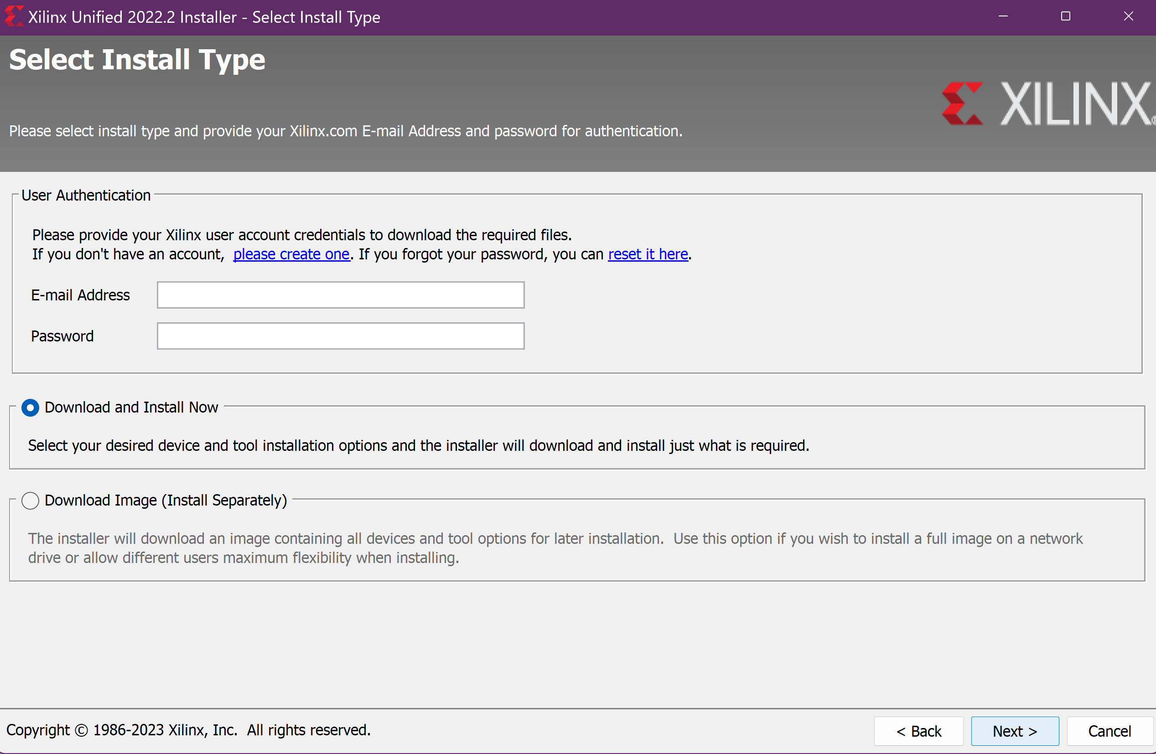
Continue by signing in
Sign in with your Xilinx account credentials

Slide 8
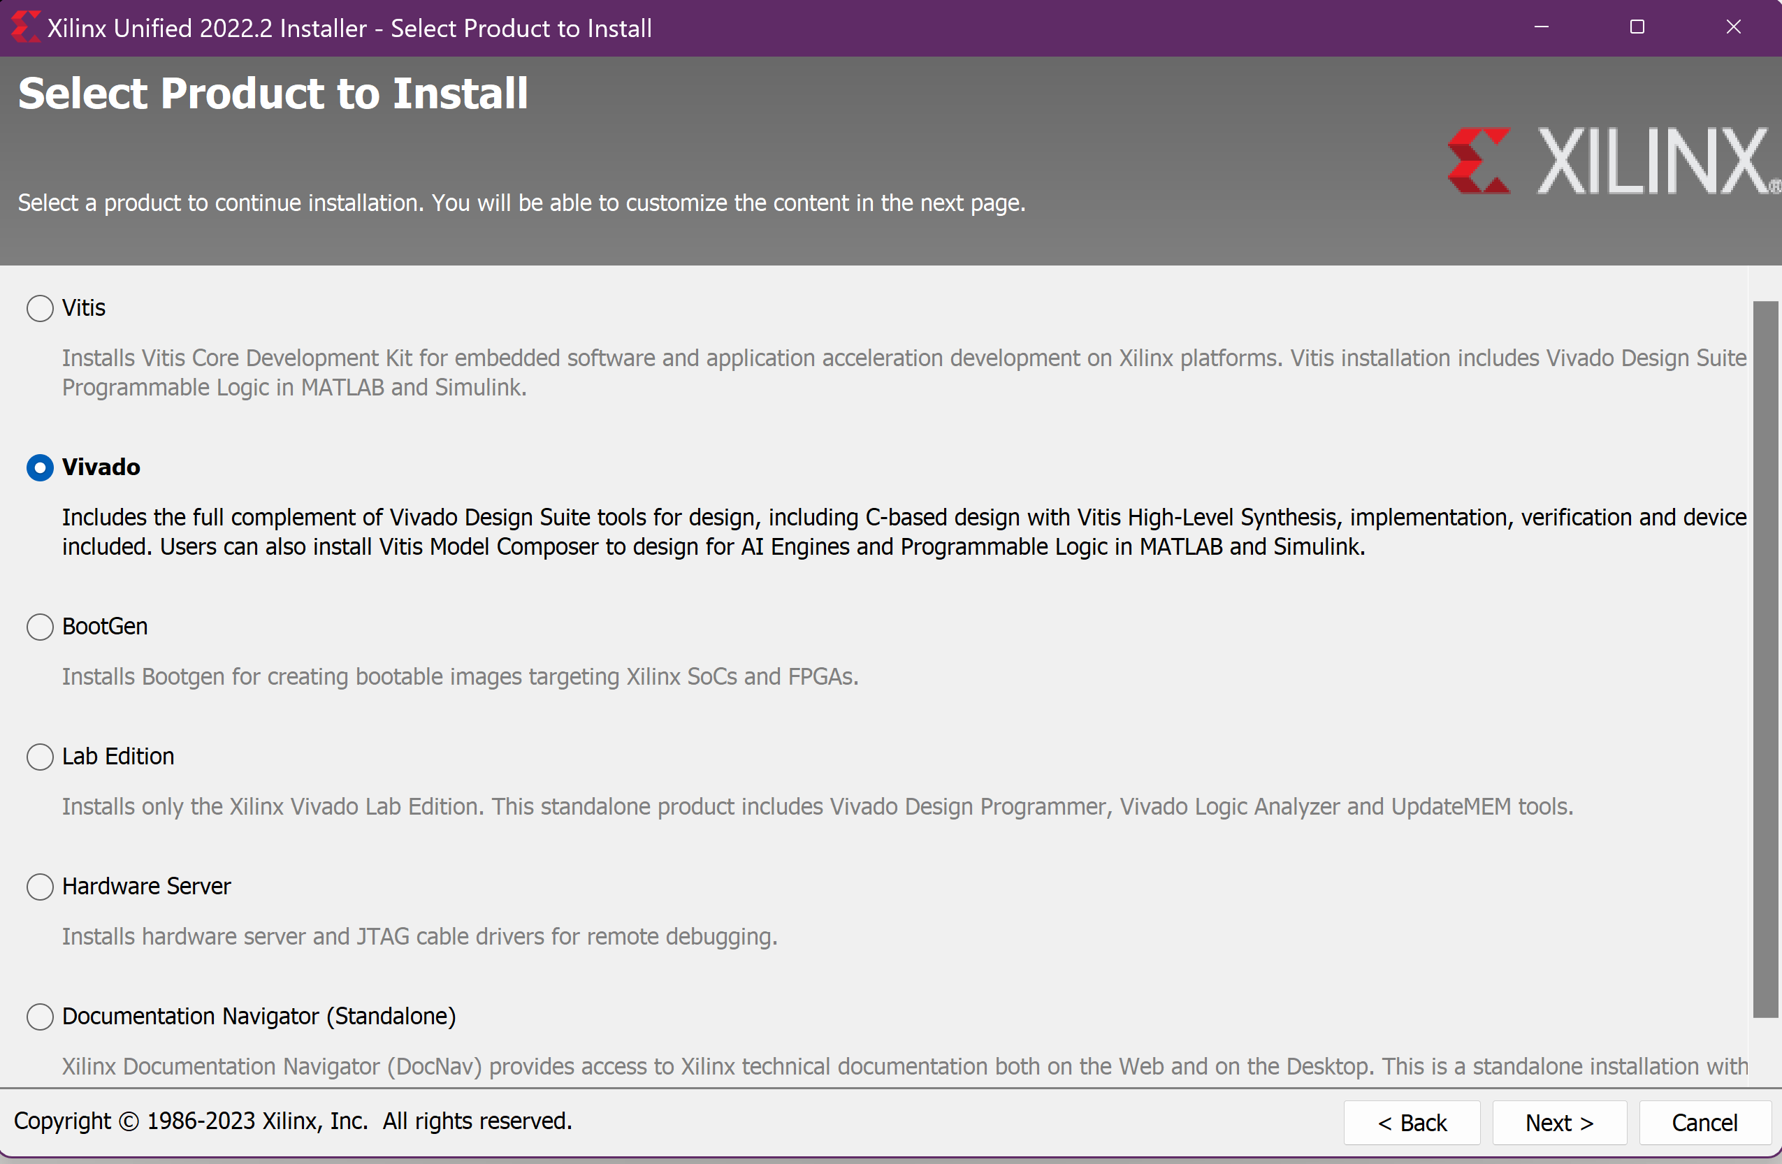
Select Vivado as product and proceed next

Slide 9
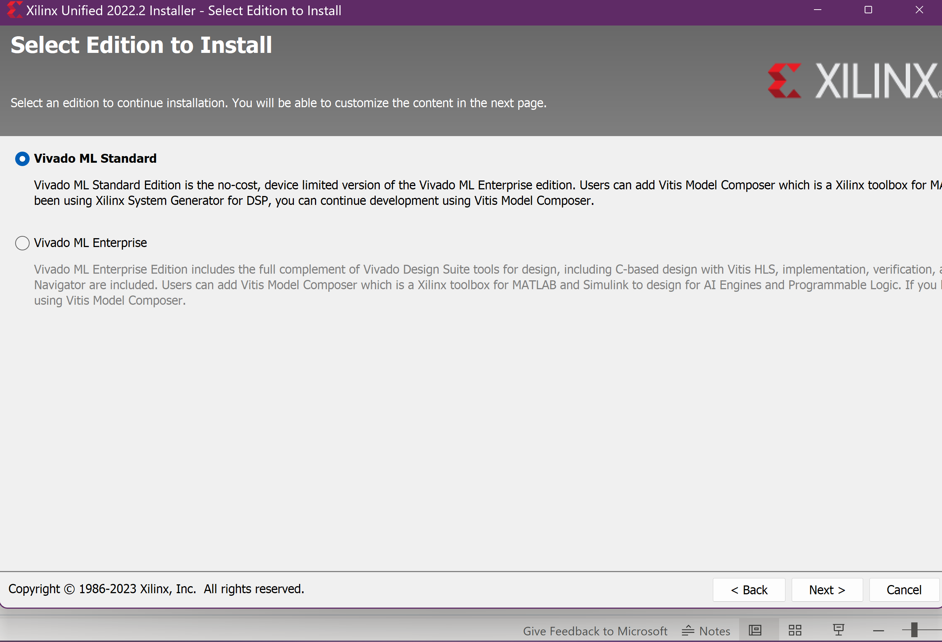
Select Vivado ML standard edition and proceed

Slide 10
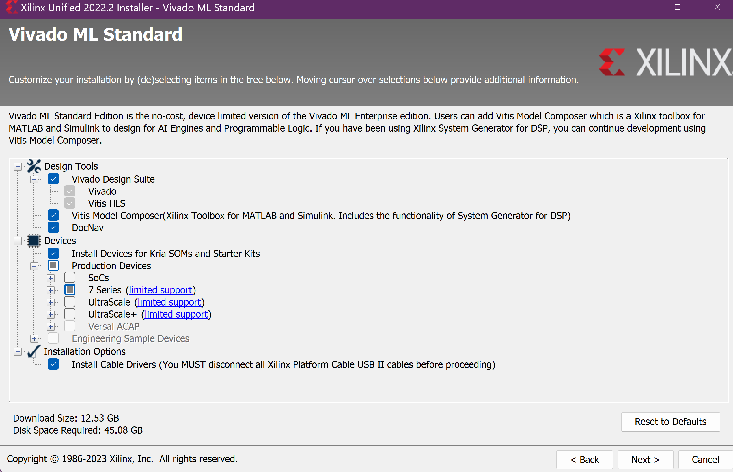
Continue with following components selected
Required Diskspace must be available

Slide 11
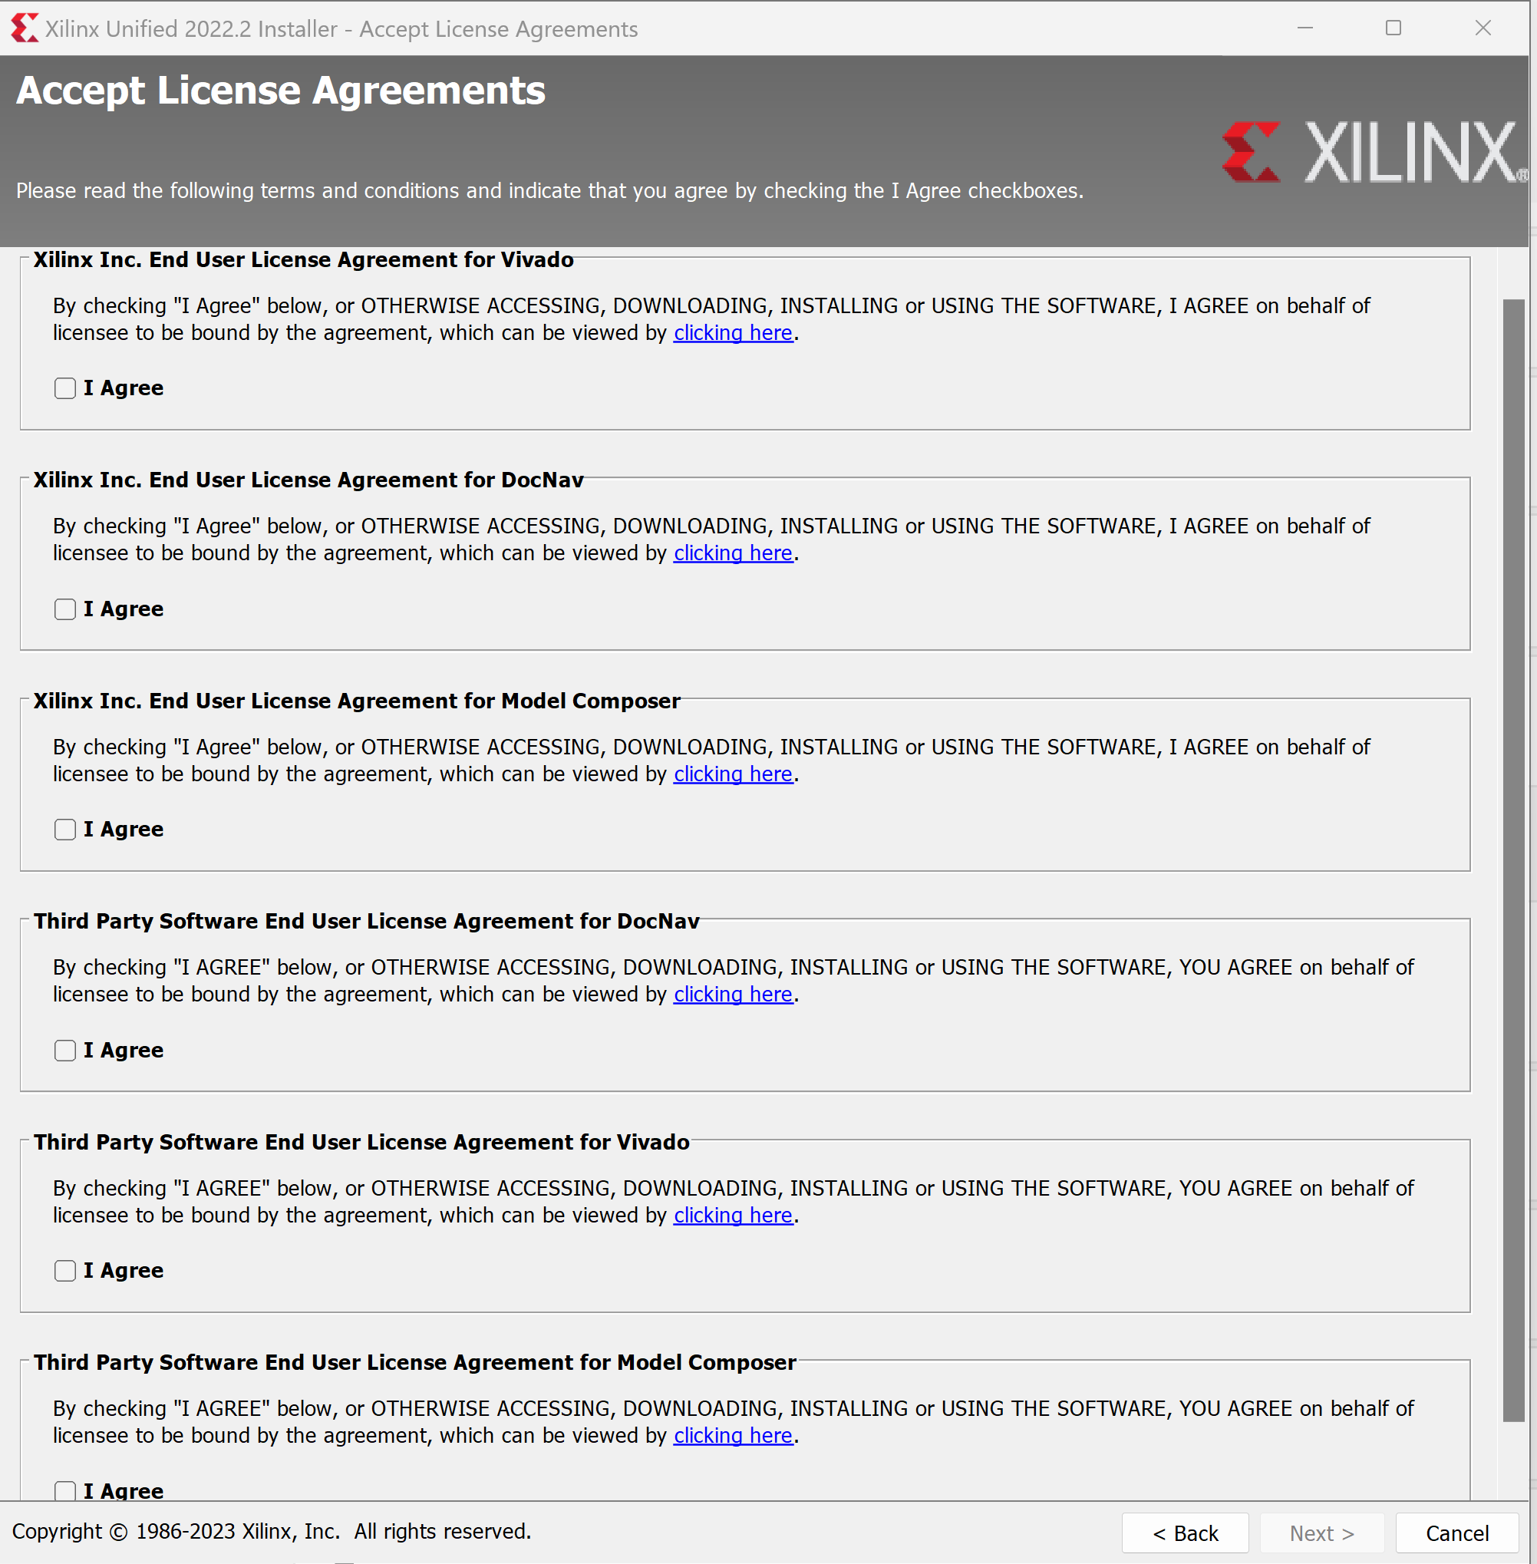
Agree to the terms and proceed next

Slide 12
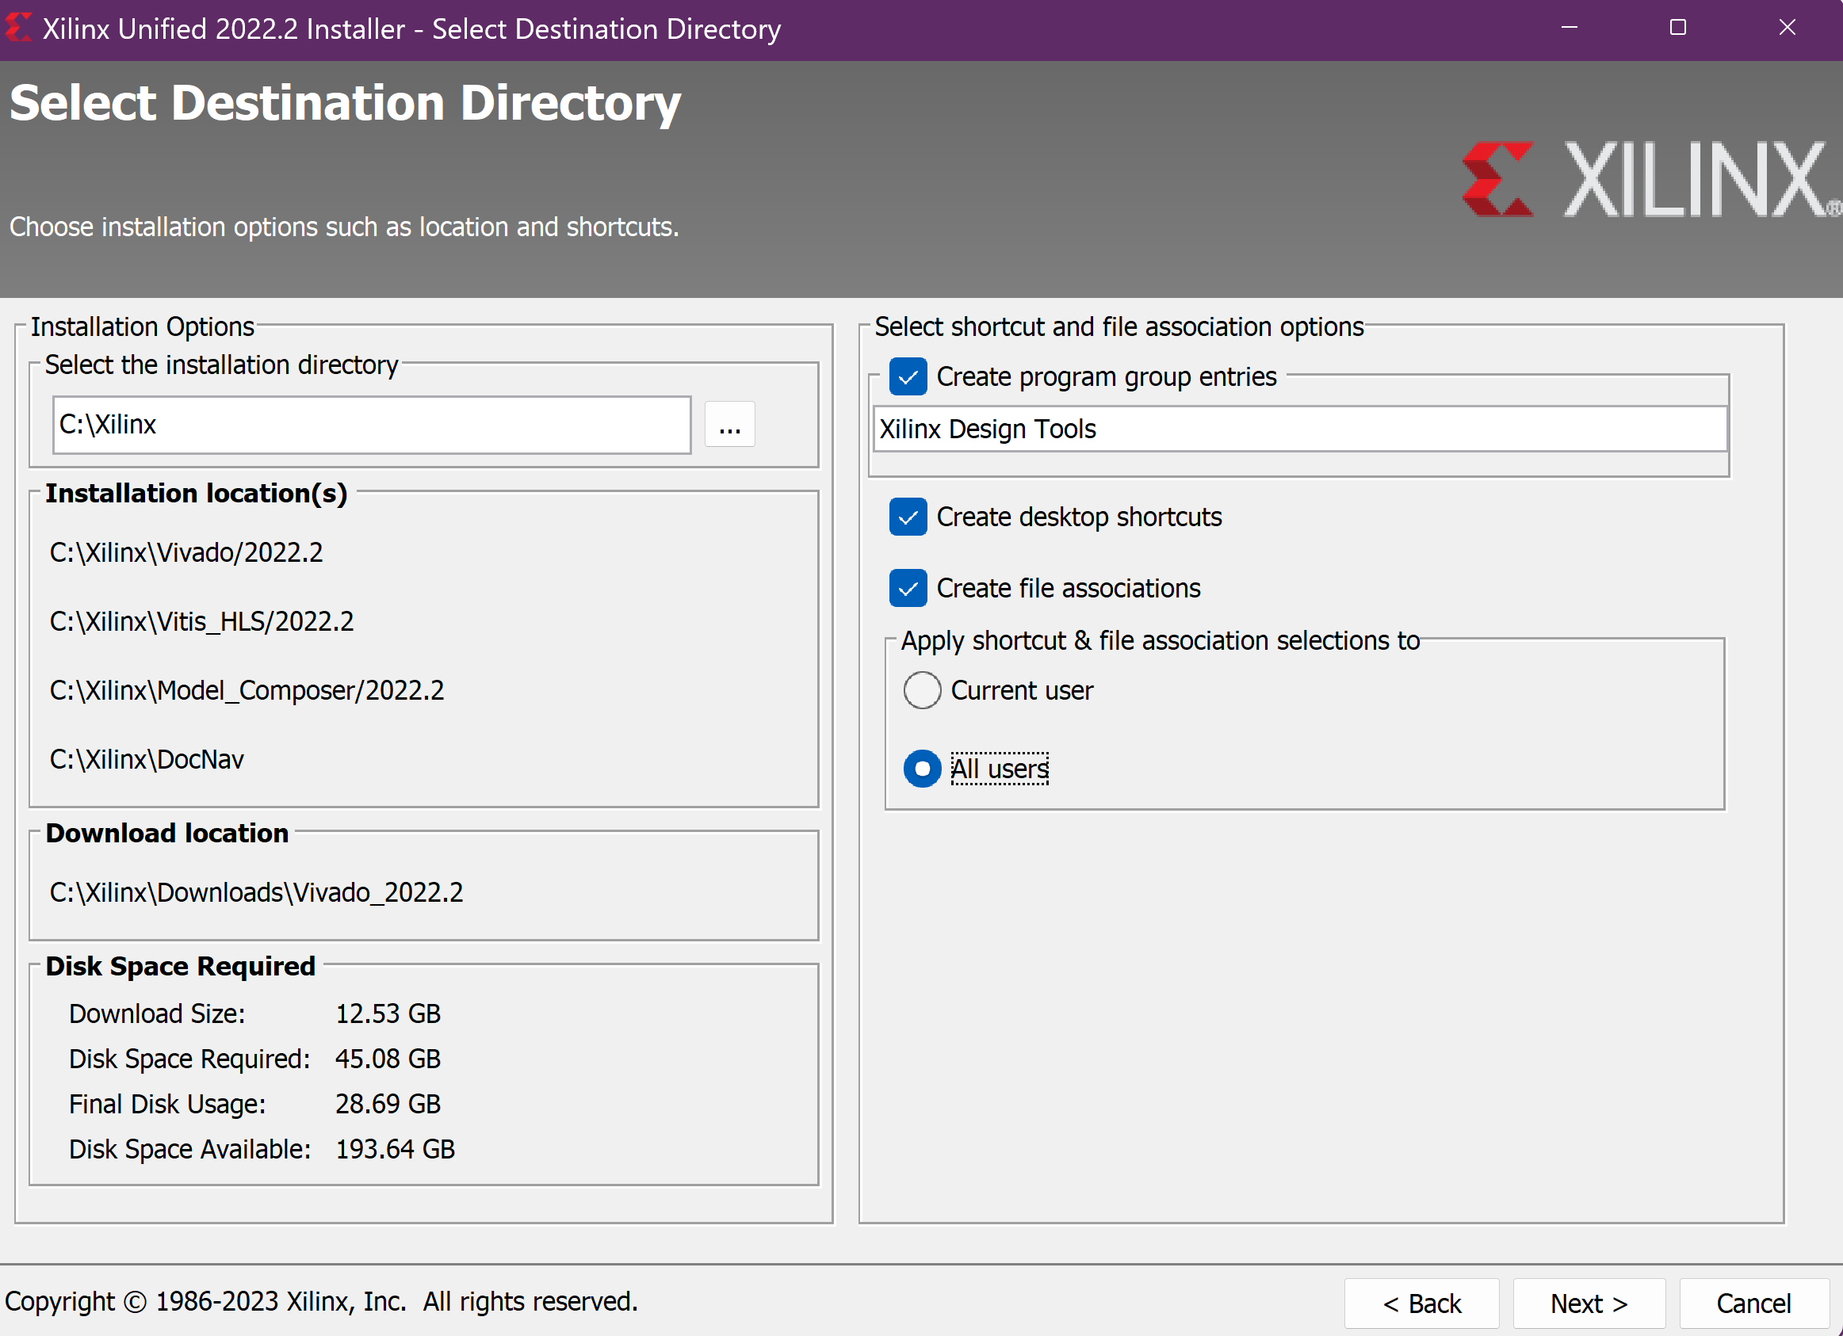
Provide installation path or go with default path
Optionally, install for all users

Slide 13
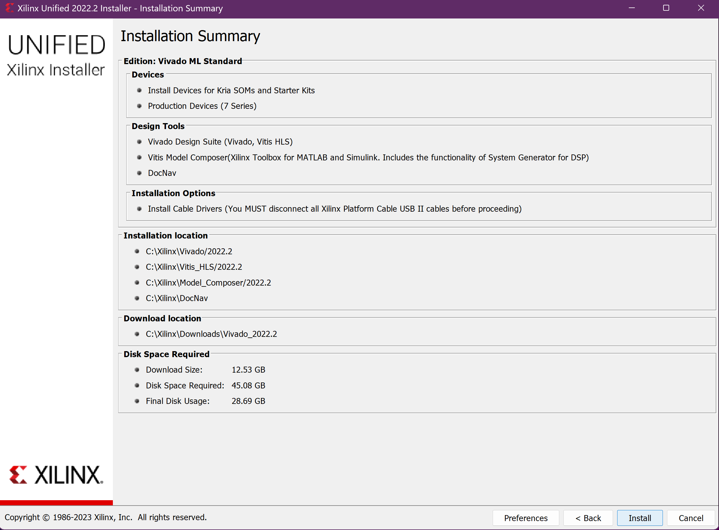
Review all the choices, then hit ‘Install’

Slide 14
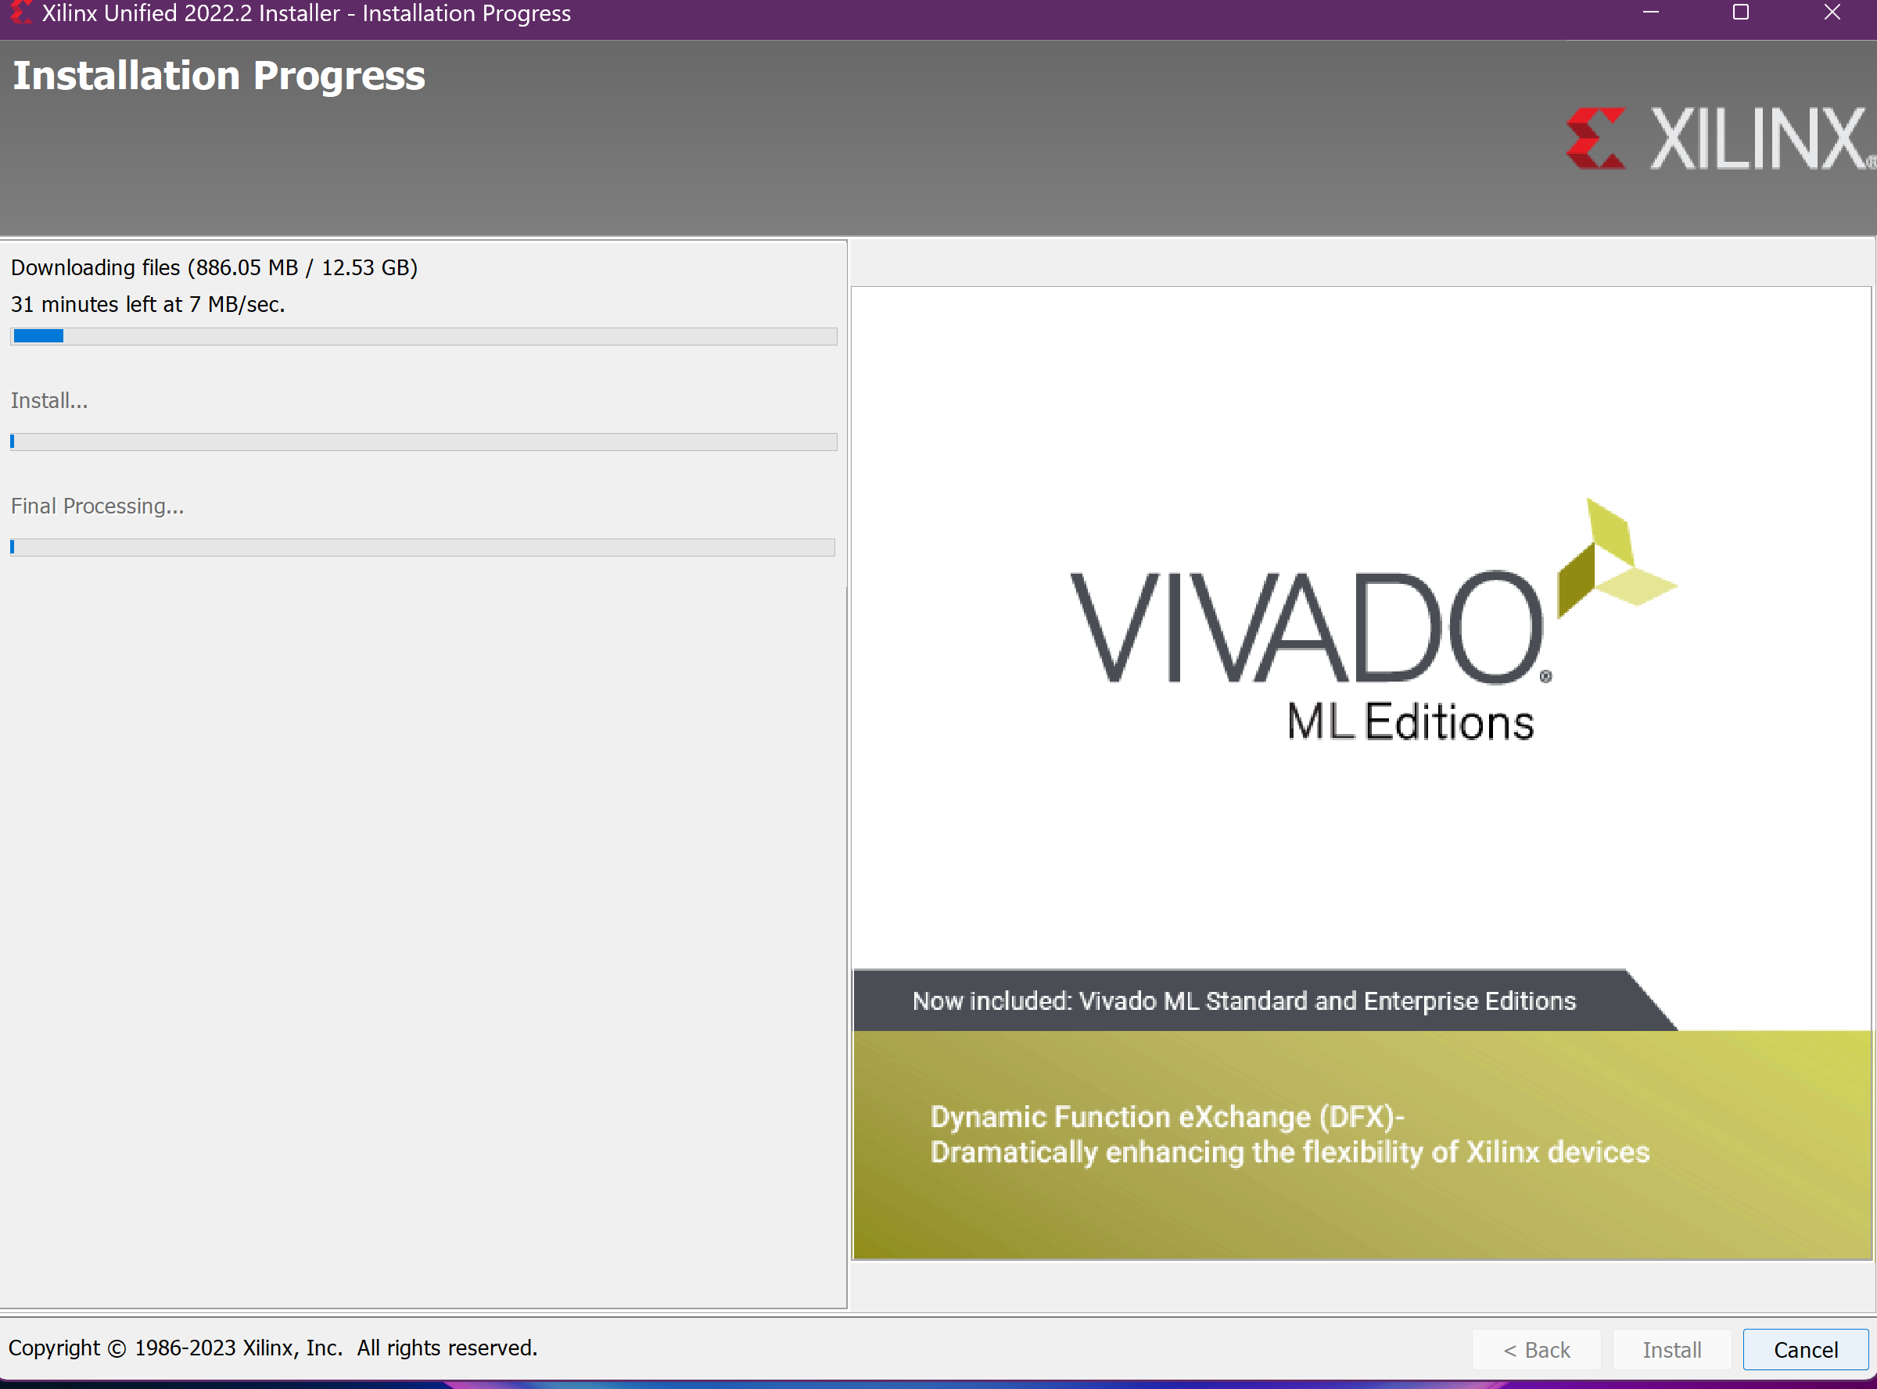
Installation begins, this will take a while

Slide 15
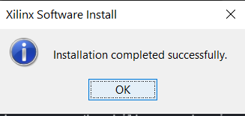
Wait until receiving Installation complete notification

